Slide 1


The Application of q-deformed Quantum Mechanics to Quantum Entangled States
Raja Muhammad Irfan
296-FBAS/MSPHY/F14
Notes:
Thank you so much for being here for my presentation.
Title of my dissertation is
15min to modeling
15min published papers
15 min to journal articles

Slide 2


Acknowledgements
Supervisor: Associate Professor Dr. Jamil Raza
Co-Supervisor: Associate Professor Dr. Waqar Adil Syed
06/21/19
Notes:
First of all I am grateful to my supervisor and co-supervisor for their guidance and support during my phd. Also I am thankful to my wife, my family, my friends and colleagues for their support.

Slide 3
Outline
Introduction
  Background
  Motivation
  Objectives
State of the art
ZX-Calculus
  Theoretical background
  Category Theory
  Diagrammatic intuition of Algebraic Equalities
  Algebraic Reasoning
  Language
  Observables Algebraic Structures
  ZX- graphical equational rules
  Universality of ZX-calculus
  Applications
Extension of Theory
Conclusion
06/21/19
Notes:
The mathematical concept of a Hilbert space, named after David Hilbert, generalizes the notion of Euclidean space. It extends the methods of vector algebra and calculus from the two-dimensional Euclidean plane and three-dimensional space to spaces with any finite or infinite number of dimensions. A Hilbert space is an abstract vector space possessing the structure of an inner product that allows length and angle to be measured. Furthermore, Hilbert spaces are complete: there are enough limits in the space to allow the techniques of calculus to be used.Background and Opportunities enabled by wind system
Control challenges of wind turbine and my contribution made to meet these challenges.
Wind turbine is discussed, low order model and simulation model shown.
To develop an effective model for the purpose of control design, A low order, compact dynamic model of wind turbine is established. The
resultant model is simple and yet, effective enough in reflecting the main dynamic characteristics of wind turbine , and is readily applicable to feedback control design.
These modes are validated by extensive experimental tests.
To synthesize a model-based multivariable control system, the LQG, DAC technique are applied . Furthermore, to control wind turbine over a wide range where system nonlinearities become evident, the multi variable controller is designed to adapt to changing operating conditions based on a gain scheduling scheme. Analytical studies whows that the multi variable control can significantly reduce the fatigue of components compared to the conventional SISO control scheme.

Slide 4
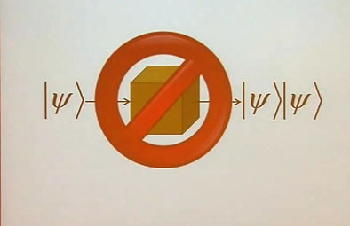
Background
        Introduction
Q-deformed Quantum Mechanics
‘No cloning theorem’ argues that its impossible to create an identical copy of an arbitrary unknown quantum state
Contrapositive argument says that they may be cloned if known to lie in the eigen basis of quantum observables
Quantum groups define some kind of Hopf algebra
Quantum group arise from q-deformation
Quantum Entangled States
Particles interact in a way that their combined state can't be explained independent of each
other, even when the particles separated by a large distance known as entangled states
Zhang, Jian-zu. "A q-deformed quantum mechanics." Physics Letters B 440.1-2 (1998): 66-68.
https://en.wikipedia.org/wiki/Quantum_group
06/21/19
Notes:
+A quantum state provides a probability distribution for the value of each observable, i.e. for the outcome of each possible measurement on the system.
+"All bats are mammals" can be restated as the conditional "If something is a bat, then it is a mammal". Now, the law says that statement is identical to the contrapositive "If something is not a mammal, then it is not “
+A Hopf algebra is a structure that is simultaneously an (unital associative) algebra and a (counital coassociative) coalgebra, with these structures' compatibility making it
a bialgebra, and that moreover is equipped with an antiautomorphism satisfying a certain property
+Quantum group denotes various kinds of noncommutative algebras with additional structure. In general, a quantum group is some kind of Hopf algebra.
Quantum group describe the symmetry of spaces s noncommutative algebra with additional structure. In general, a quantum group is some kind of Hopf algebra. This
define’s q-deformed version of quantum mechanics

Slide 5
Motivation
Introduction
Graphical interpretation to physical concepts
Powerful graphical equational rules
Commutation for complementary observable algebraic structures
Universality of graphical language
Graphical representation to physical system and processes
06/21/19

Slide 6
Objectives
Introduction
Introducing ZX-calculus and the associated graphical equational rules
Measuring physical quantities graphically i.e. amplitude and hence probability
Representing states particularly entangled one on the basis of these graphical structures
Analysis of their physical properties i.e. inner product and reduced density matrix by these graphical methods
06/21/19

Slide 7
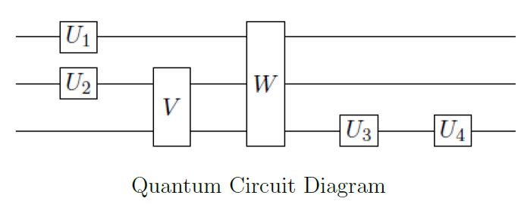
Background Graphical Languages for Quantum Process Representation
State of the art
Conventional Quantum Circuit Notation
Language derived from classical logic gates
Arbitrary unitary gates for single qubit and two-qubit controlled-NOT gate known as universal quantum gate set
Any unitary operation on a finite number of qubits can be expressed as a quantum circuit using universal quantum gate set
06/21/19

Slide 8
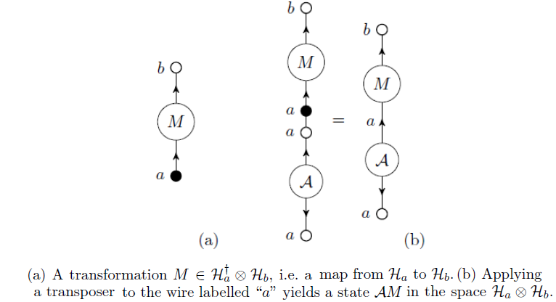
Background Graphical Languages for Quantum Process Representation
State of the art
2. Atemporal diagrams
A temporal diagrams are the generalization of quantum circuit diagrams
It is the representation of time reversal
A state in can be thought of as map from Ha dagger to Ha.
Deficiencies
Neither defined in exact manner nor widely accepted rules
Quantum circuits do not allow curved wires or cycles
06/21/19

Slide 9
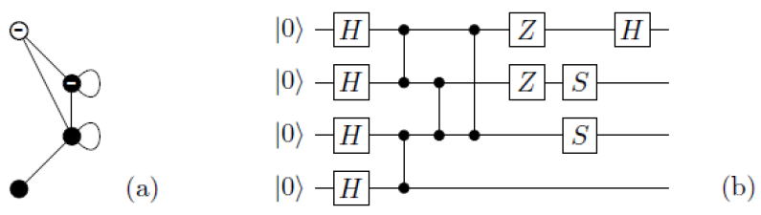
Background Graphical Languages for Quantum Process Representation
State of the art
3. Stabilizer Graphs
Pure qubit stabilizer states can be represented as decorated graphs known as stabilizer graphs
They are simultaneous eigenstates of a group of Pauli products
Graph states considered as a particular class of stabilizer states
Stabilizer graph notation extends the graph state notation to generalize stabilizer
Figure(a): A stabilizer graph
Figure(b): quantum circuit for preparing the corresponding stabilizer state. Z-gates to minus signs, S-gates to self-loops, and Hadamard gates to empty nodes.
Deficiency
Define only for fragment of quantum theory
06/21/19

Slide 10




Category Theory
Theoretical Background
Graphical languages made rigorous using the framework of category theory
Monoidal Categories used to analyze complex quantum networks
A Category C consists of objects A, B, C, ... and for each pair of objects A, B € Ob(C) a set of arrows or morphisms C(A,B)…
There exist associative sequential composition for each triple
For every object , there exist an identity morphism
Functor F : C D transform category C to category D. Category D has objects FA,FB,… and arrows Ff , Fg ,… satisfies
i.e. The map from category Set to Rel sends each of the function to a relation
06/21/19
Notes:
+Category theory formalizes mathematical structure and its concepts in terms of a labeled directed graph called a category, whose nodes are called objects, and whose labelled directed edges are called arrows (or morphisms). A category has two basic properties: the ability to compose the arrows associatively and the existence of an identity arrow for each object.

Slide 11

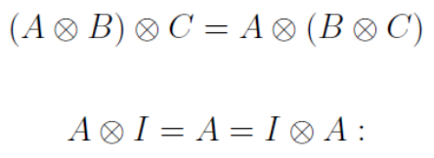
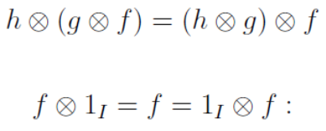


Category Theory
Theoretical Background
A strict monoidal category is a category C together the operation of parallel composition for objects, denoted by
, a unit object I and a parallel composition operation for arrows
For objects and arrows
“Strict” refers to the fact that they both have same structure and parallel and serial composition satisfy the
interchange law
i.e. Fhilb is denoted by MatC, has objects represented by natural numbers with parallel composition of objects
, 1 as unit object. Arrows compose in parallel by Kronecker product of matrices
06/21/19

Slide 12


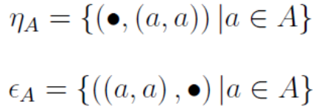


Category Theory
Theoretical Background
Compact closed category For every object A € Ob(C) there is another object A’ € Ob(C) called dual object
satisfies
i.e. The category Rel can be given a compact structure because A ₌ A’ is a relation and consider relations
as subsets { •× (A× A’) } and {(A× A’) × •}
A dagger functor on a category C is identity on objects just reversing direction of arrows
06/21/19

Slide 13
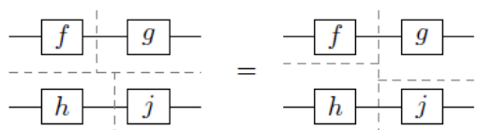

String diagrams, algebraic equalities, and graph isomorphisms
Theoretical Background
Languages that represent processes as string diagrams. String diagrams can be translated into algebraic terms using only horizontal and vertical cuts and than into and than into segments
Interchange law is tautological in diagrams .
By the dentition of compact structures maps are represented by cup and cap whose sequential composition produces, snake equations. Snake equations are not tautological in string diagrams, they do correspond to simple graph isomorphism. A graphical language is useful only if all the intuitive diagrammatic equalities correspond to true equations derived from the axioms of the category
06/21/19

Slide 14
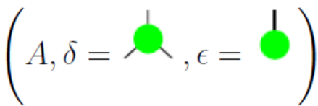
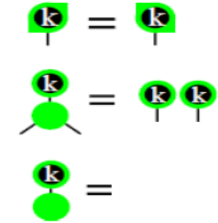
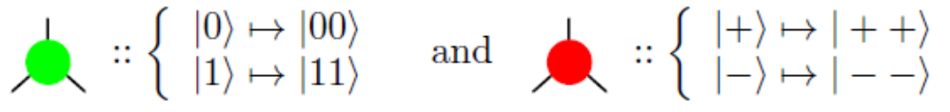
Complementary Algebraic Structures
ZX-calculus
An observable algebraic Structure defined to be a special commutative dagger-Frobenius algebra.
Classical Points are self conjugate homomorphism graphically shown as
Complementary algebraic structures are
06/21/19

Slide 15

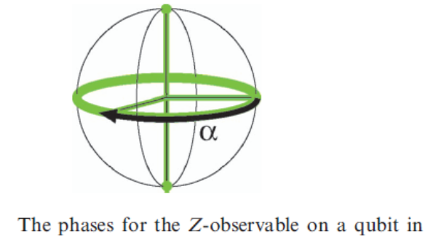


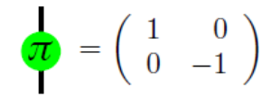





Phase Group
ZX-calculus
For the Z observable on a qubit Q in FHilb we have unbiased points and unitary
morphims obtaining phases and hence call this group the phase group.
The multiplication in the group corresponds to adding angles
A red or green spider which have only one input and one output and arbitrary phase to them represent their phase
shifted version. Pi phase shifts leads to pauli matrices
Z-basis vectors
06/21/19

Slide 16
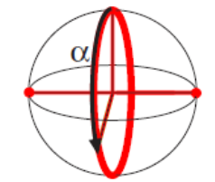
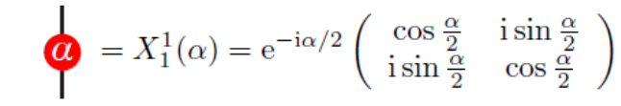
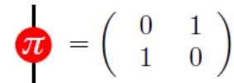


Phase Group
ZX-calculus
For the X observable on a qubit Q in FHilb we have the same
06/21/19

Slide 17
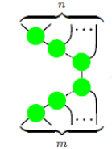
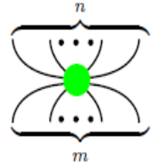


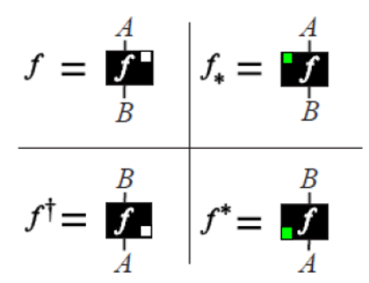
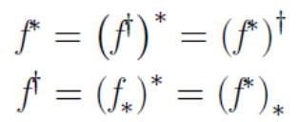
Observables Algebraic Structures
ZX-calculus
Representation of n+m legged spider through sequential composition of algebraic structure
For a morphism f : A B , its transpose and conjugate is defined as
which is coherent with the fact
06/21/19
Notes:
+An involutive commutative monoid

Slide 18
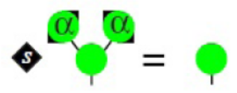
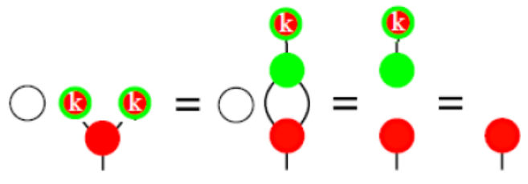

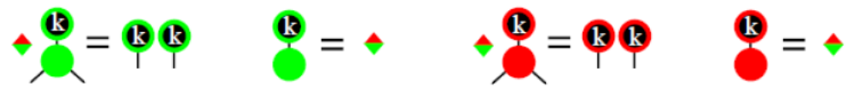
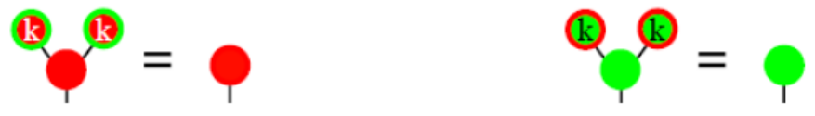
Complementary Algebraic Structures
ZX-calculus
Point α is unbiased if there exist a scalar s such that
For complementary observable structures, sequential composition obeys Hopf law
When k is unbiased structure having length square root of D rather than being normalized
also
06/21/19

Slide 19
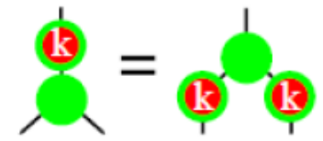
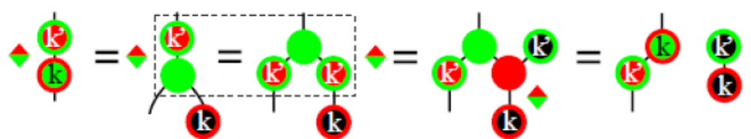
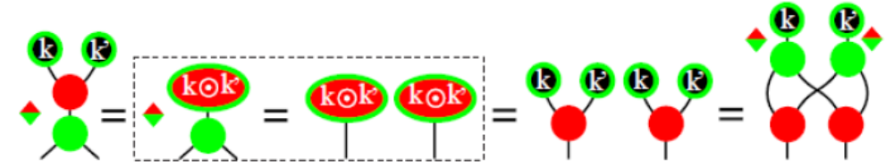
Complementary Algebraic Structures
ZX-calculus
We have derived the following commutation properties from these structures
Shows commutation for non-commuting observables
Scaled variant of bi-algebra
06/21/19

Slide 20
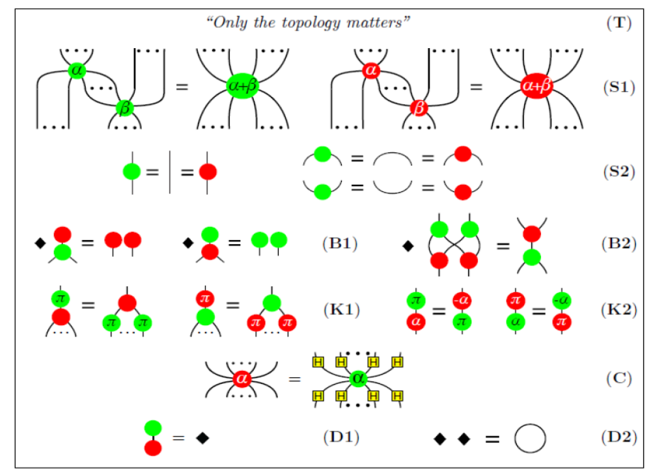
ZX- graphical equational rules
ZX-calculus
06/21/19

Slide 21
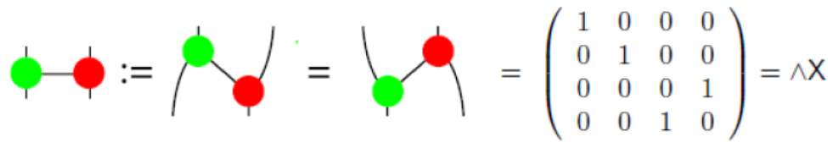

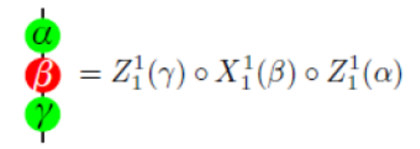
Universality of ZX-calculus
ZX-calculus
Our work is based upon ZX-calculus
ZX-calculus is universal as it straightforwardly convert a universal set of quantum gates into the ZX-calculus
06/21/19

Slide 22
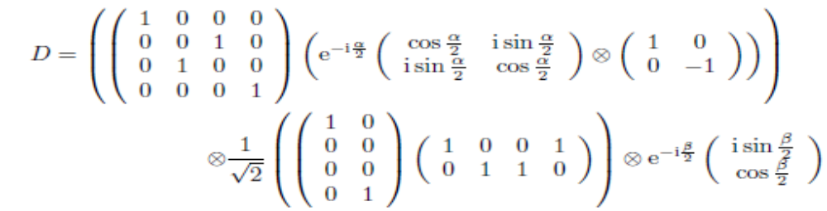
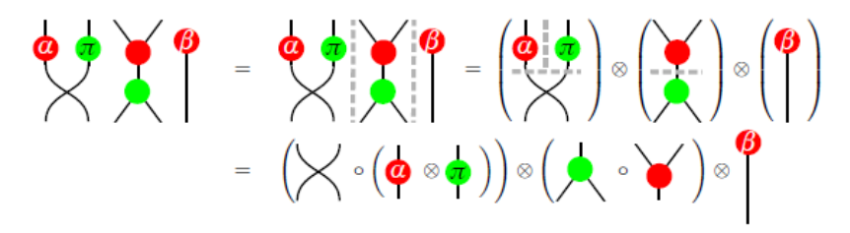
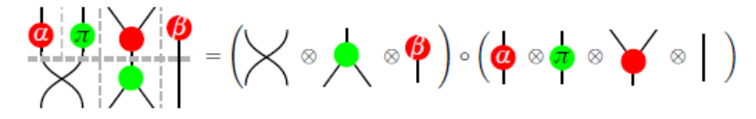
Graphical alternate to Matrix mechanics
Applications
Matrix becomes involved and tedious when we take their composition both horizontally and vertically
Conceptual properties are also not clearer e.g. whether a matrix acting on multiple systems represents a local transformation or not
Our work put all these things aside because it present graphical interpretation to the physical
concepts
06/21/19
Notes:
Associate graphical language with it which provide an intuitive and visualize way to understand
Address the compoundness of complex quantum networks
Remove ambiguities and gave answer to the questions raised regarding quantum foundation within the framework of quantum mechanics
Solve complex computational schemes graphically
Present graphical interpretation to physical concepts i.e. sequential composition of two controlled X-gates is equivalent to the identity map
complementary observables present change in their topology

Slide 23
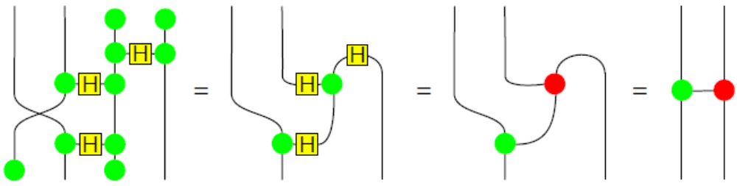
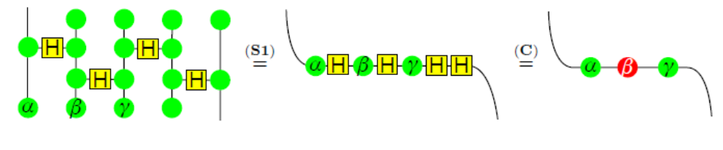
Derivation of Unitary Maps
Applications
First controlled NOT gate
Any single qubit unitary map
06/21/19

Slide 24

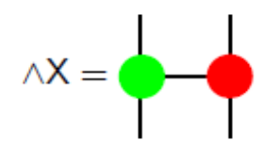
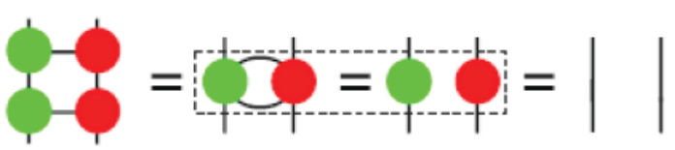
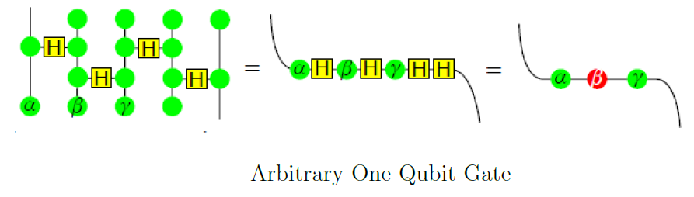
Physical Concepts
Applications
Graphical interpretation to physical concepts;
CNOT Gate and its graphical representation
Sequential composition of CNOT Gate equivalent to identity map gives rise to the following graphical interpertation
Euler-angle decompositions
06/21/19
Notes:
A linear map is represented by a matrix (a 2-dimensional array) in a basis, and therefore is a 2nd-order tensor. A vector is represented as a 1-dimensional array in a basis,
and is a 1st-order tensor. Scalars are single numbers and are thus 0th-order tensors. The collection of tensors on a vector space forms a tensor
complementary observables present change in their topology

Slide 25
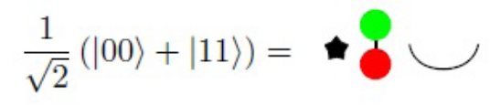



Amplitude Derivation
I extend this work to the representation and analysis of the states
Applications
Bell state representation
Graphical representation of Bell state
Computational and Hadamard basis measurements represented as follows
Computing amplitude of Bell state in the state
06/21/19

Slide 26




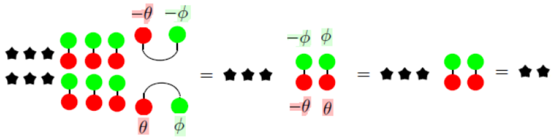
Amplitude Derivation
The probability corresponding to the state
Overlap of Bell state with the measurement
Similarly for the probability correspond to
06/21/19

Slide 27
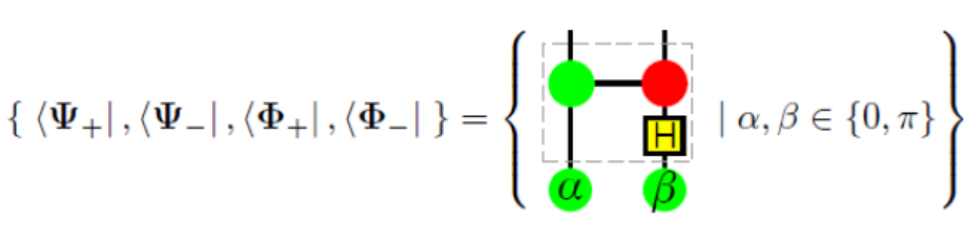
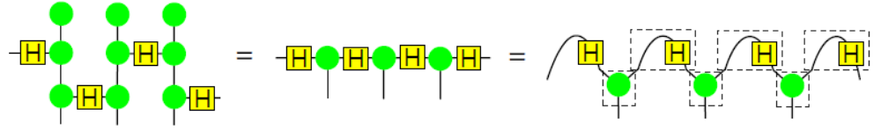
Representation of Entangled States
Bipartite Entangled States
Bell states diagrammatically shown as
The boxed part indicates the rotation of the Bell basis onto the X-basis
Multipartite Entangled States
Cluster States
06/21/19

Slide 28
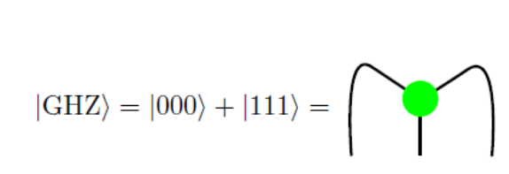
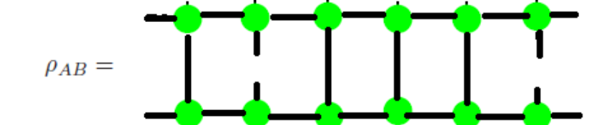

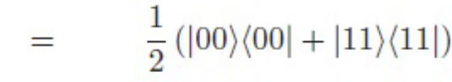
Representation and Analysis of Entangled States
Genuine three qubit Entangled State
GHZ state
Its importance stem from the fact that simple form takes to the concept of algebraic structure
GHZ state
We can calculate reduced density matrix
Clearly expose entangled state nature and using this approach product state nature is also revealed
Denny, S. J., et al. "Algebraically contractible topological tensor network states." Journal of Physics A: Mathematical and Theoretical 45.1 (2011): 015309
06/21/19
Notes:
+A density matrix is a matrix that describes a quantum system in a mixed state, a statistical ensemble of several quantum states

Slide 29
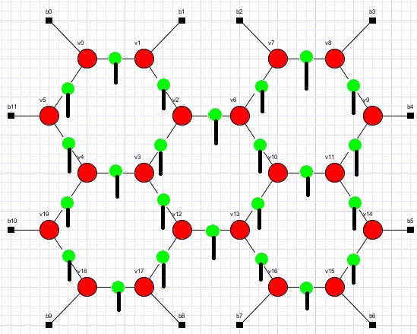
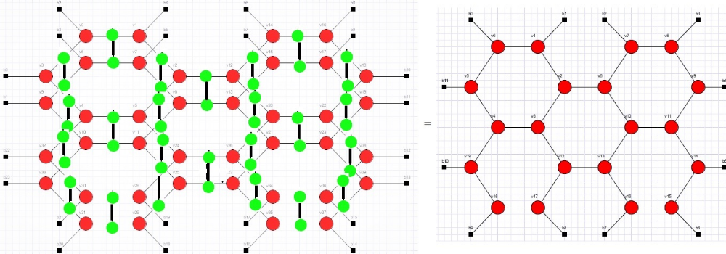

Representation and Analysis of Product States
Product State
Z2 tensor network representation
06/21/19

Slide 30
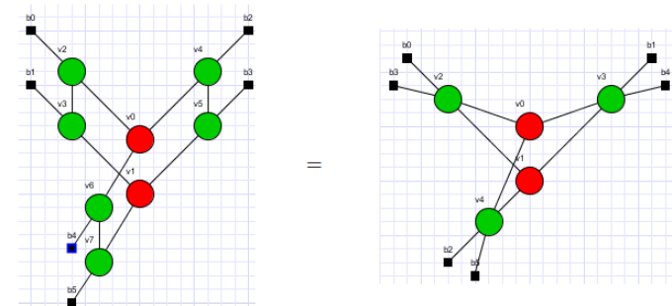
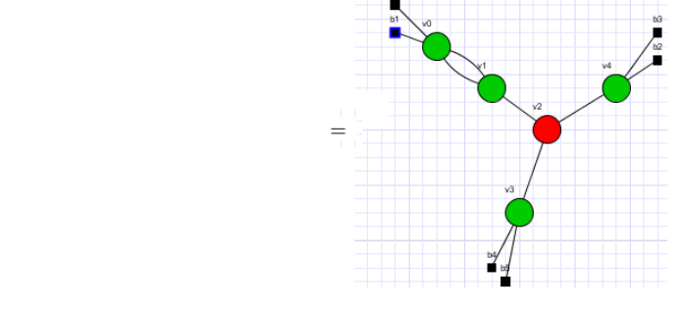
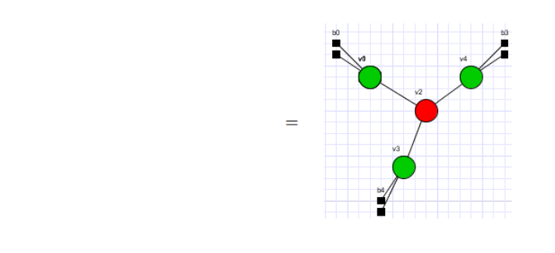
Representation and Analysis of Product States
Product State
Derived from Fusion ,Bi-algebra rules
06/21/19

Slide 31


Representation and Analysis of Product States
Product State
Two site reduced density matrix
Fusion rule simplifies to
06/21/19

Slide 32




Representation and Analysis of Product States
Product State
Via Bialgebra law
Via Hopf and fusion rule
At the end it clearly exposes product states nature shown by disconnection between green dots.
06/21/19

Slide 33
Conclusion
ZX-calculus have the power to represent not only the product states but also the entangled states in much intuitive and formal way. Powerful graphical equational rules associated with it prove to be an exact choice for exposing the nature of the states in intuitive way.
We have exposed the nature of the entangled state in comparison to the product states via their reduced matrices by using these equational rules. We have computed other physical properties of states as well by using these graphical equational rules in an intuitive way.
Lastly I want to say that it provide an intuitive way to analyze states and their properties.
06/21/19

Slide 34
Thanks for your attention!
Notes:
Introduction
Name,

